Slide 1
Los Angeles Clean Streets Index Analysis

Slide 2

Questions We Addressed
We want to determine if there is a correlation between clean streets using the Los Angeles Clean Streets Index and other city features, such as household median income and crime locations.
If we find a correlation between these features, then we can create a business use case in which we recommend certain street areas with high scores from the Clean Streets Index where business owners could build their businesses.
This way, we could incorporate household median income as a proxy for communities with more disposable income that people could spend at these new businesses.
Rate of burglary and break-ins that occur in a given area may also have an effect on where someone may choose to locate a new business.
By identifying high-crime areas we hope to be able to recommend safer areas for prospective business owners to locate their new franchises.

Slide 3
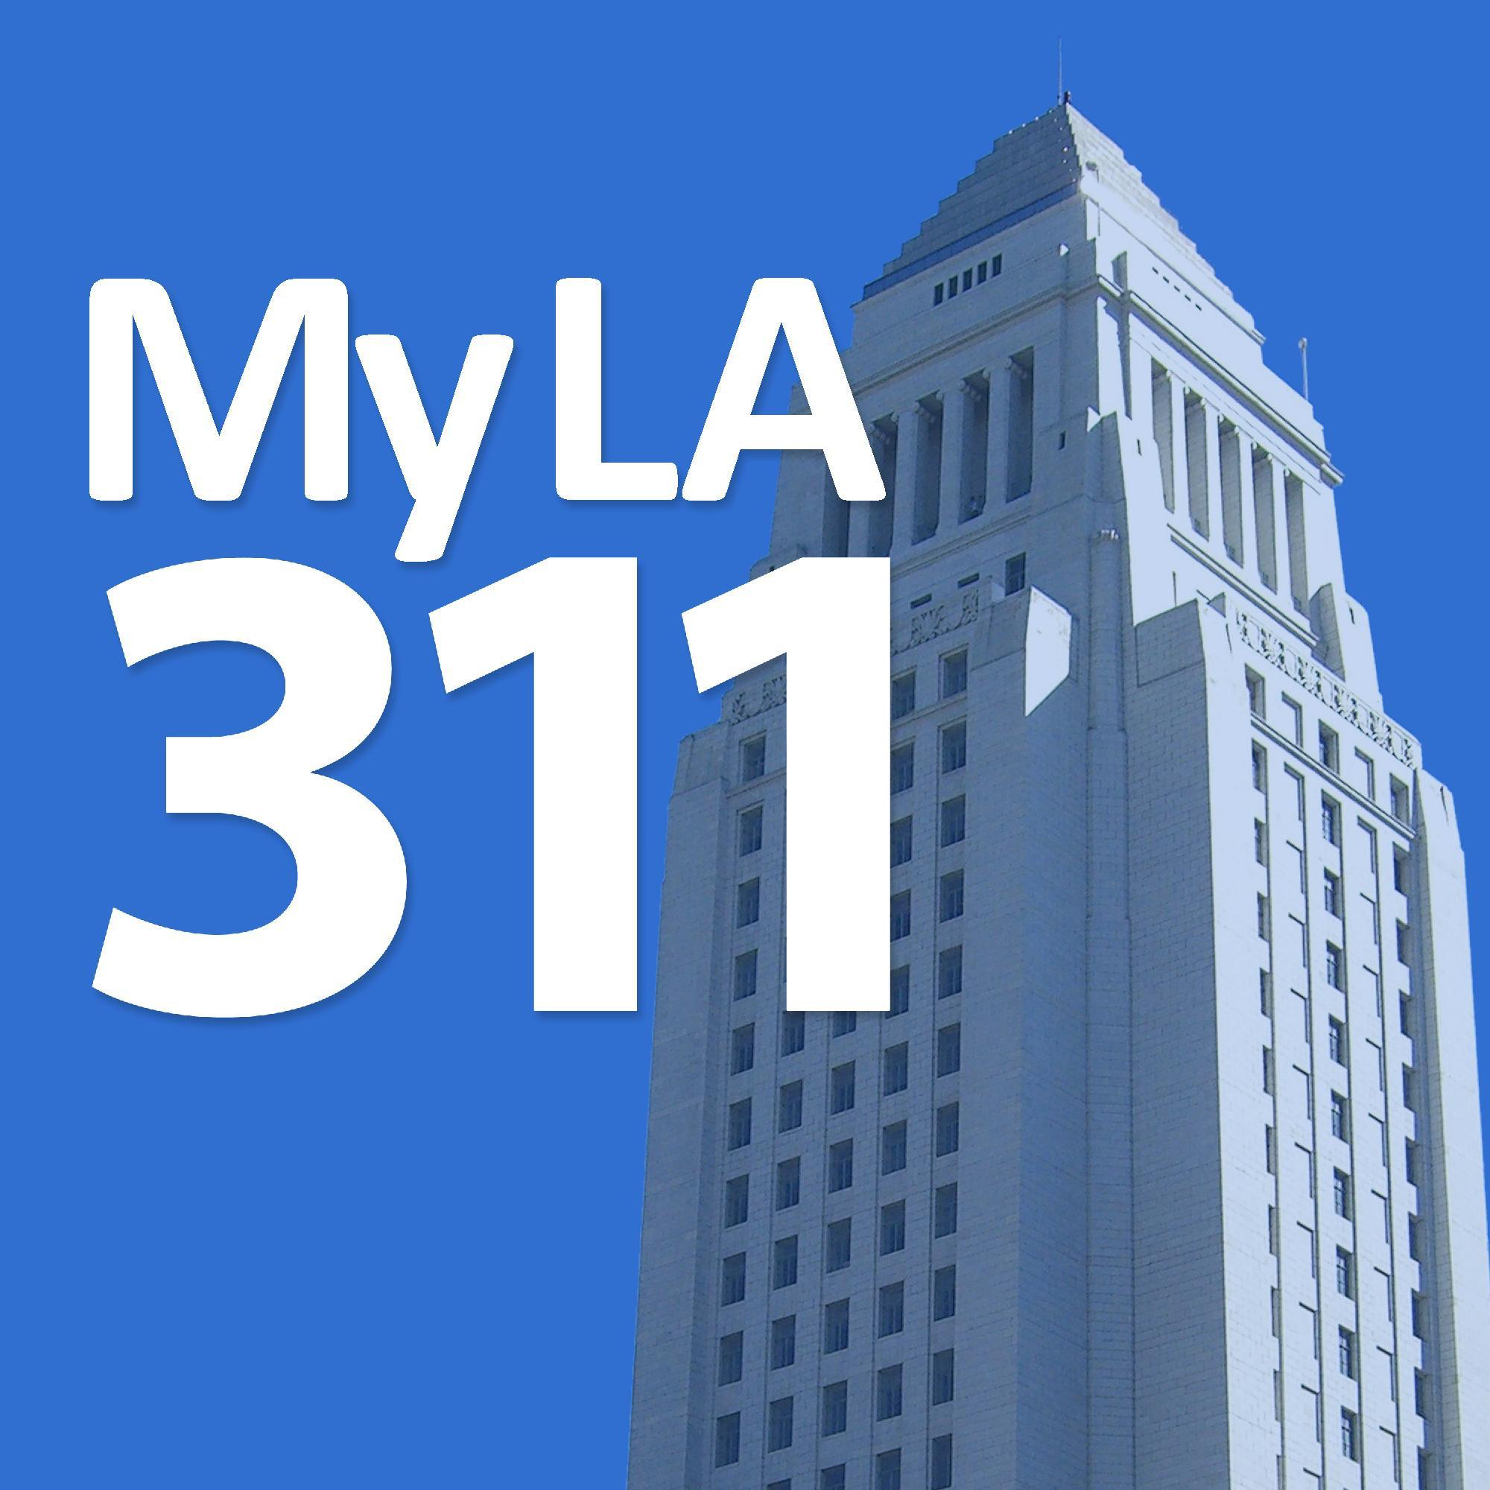
Background & Literature
Hein Online
Describes the relationship between crime and real estate redevelopment in Downtown Los Angeles.
According to this article, Los Angeles’ Skid Row is at the epicenter of an urban struggle that may reveal how America’s disorderly urban neighborhoods experience change.
Taylor and Francis Online
Examines how local repressive policies affect the economic mobility of immigrant fruit vendors in Los Angeles County.
We expect to confirm their findings since there exists a correlational divide between income and race.
City of Los Angeles GitHub
The data that will be most important to us is the Council District shapefiles as well as the 311-Call-Center-Tracking-Data.

Slide 4
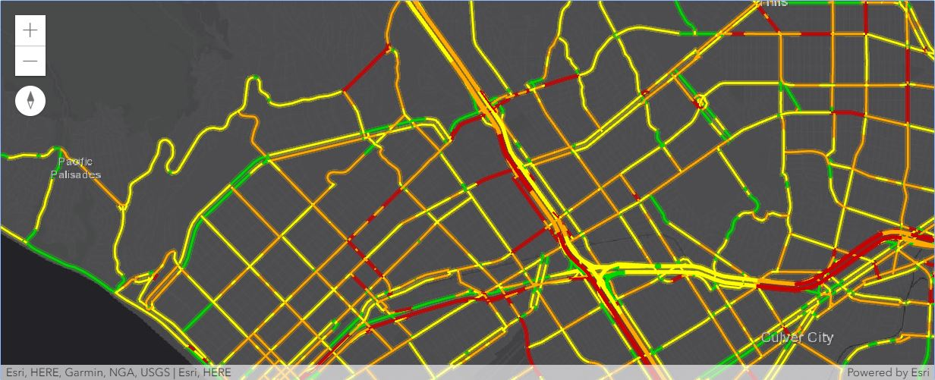
Traffic Near Westwood/UCLA
1:46pm

Slide 5
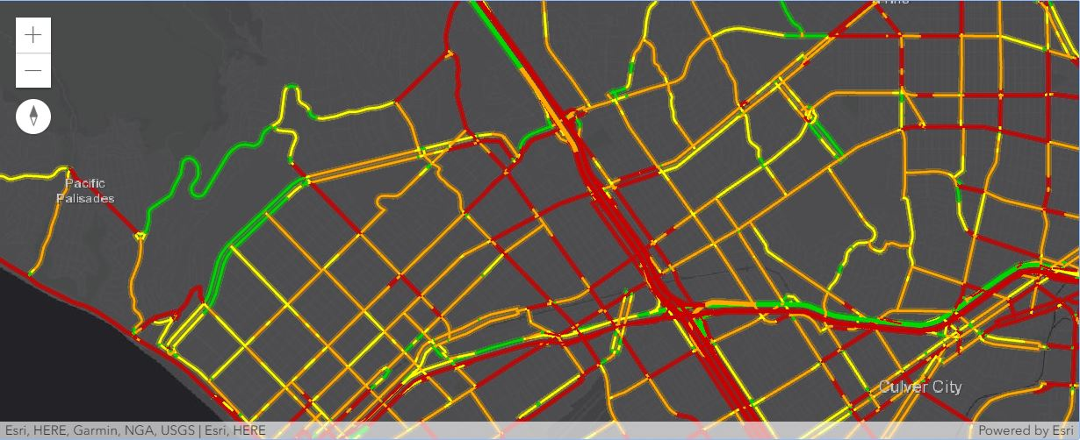
Traffic Near Westwood/UCLA
4:37pm

Slide 6
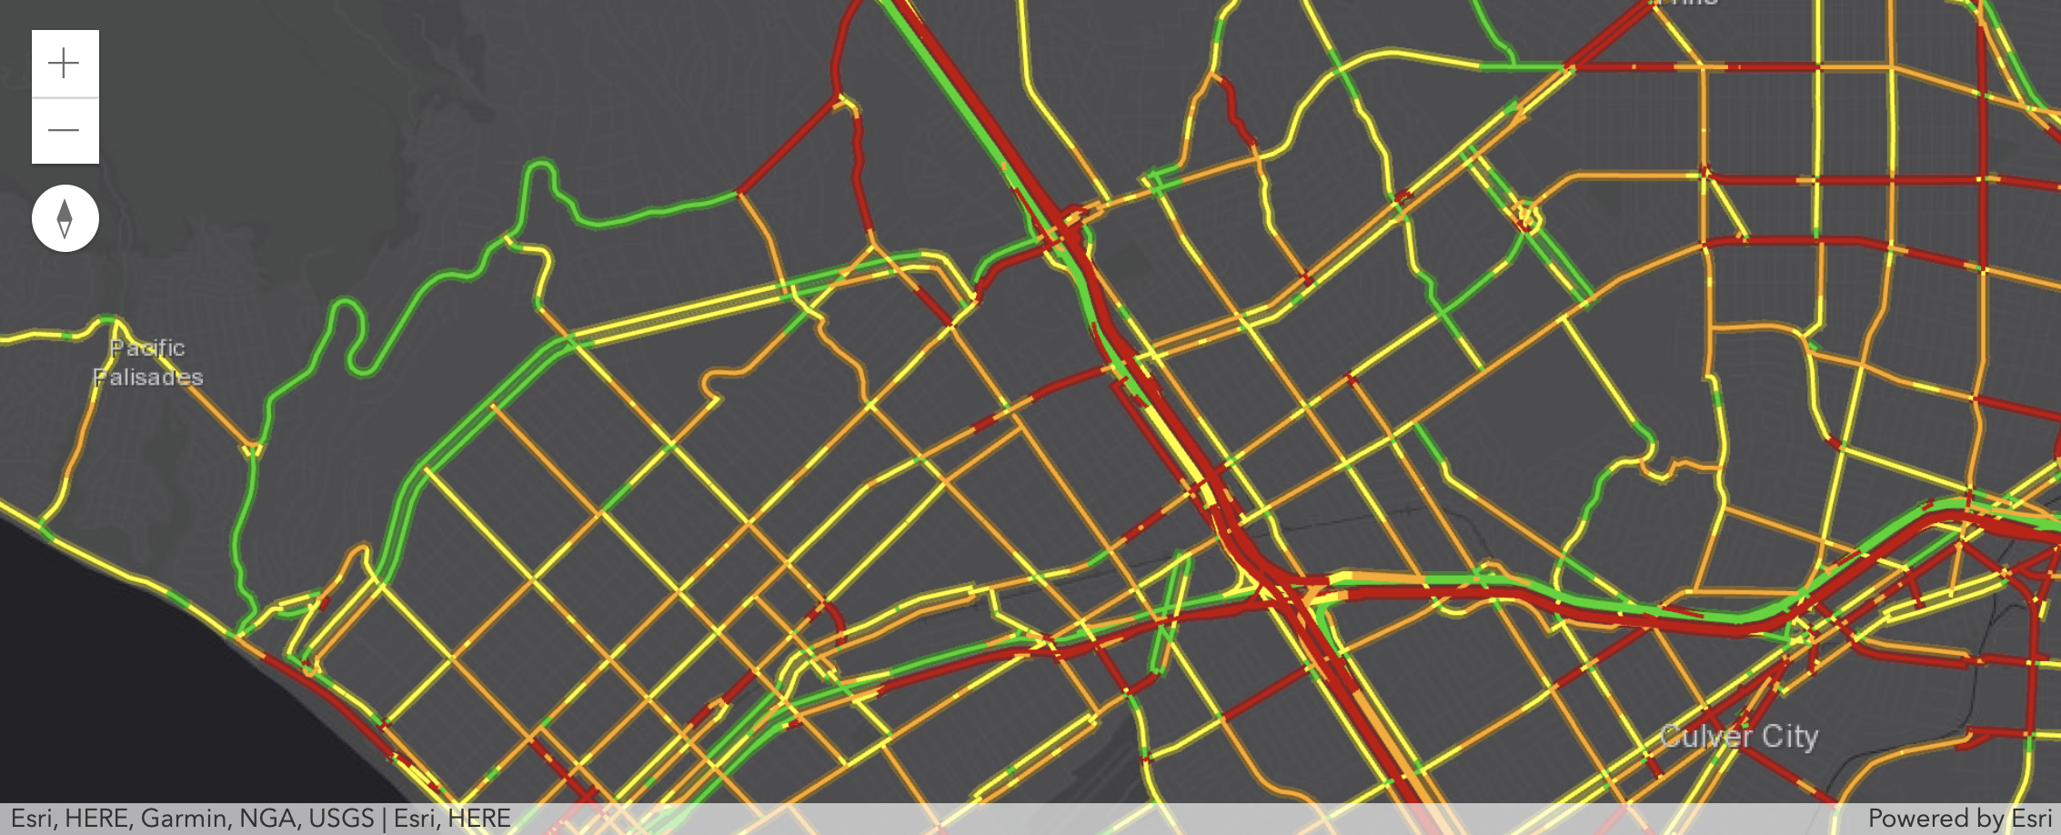
Traffic Near Westwood/UCLA
7:35pm

Slide 7
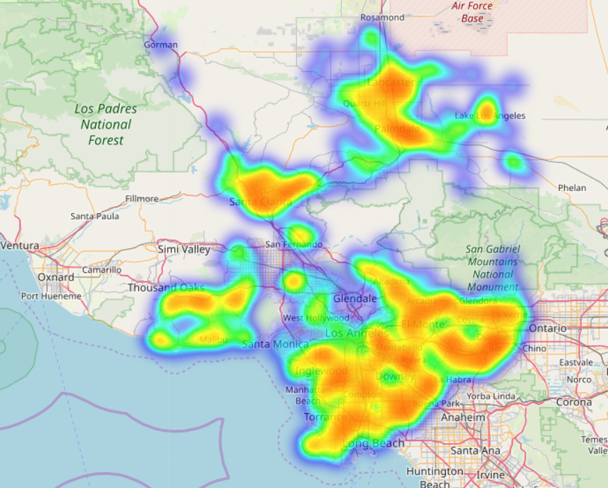
Crimes

Slide 8

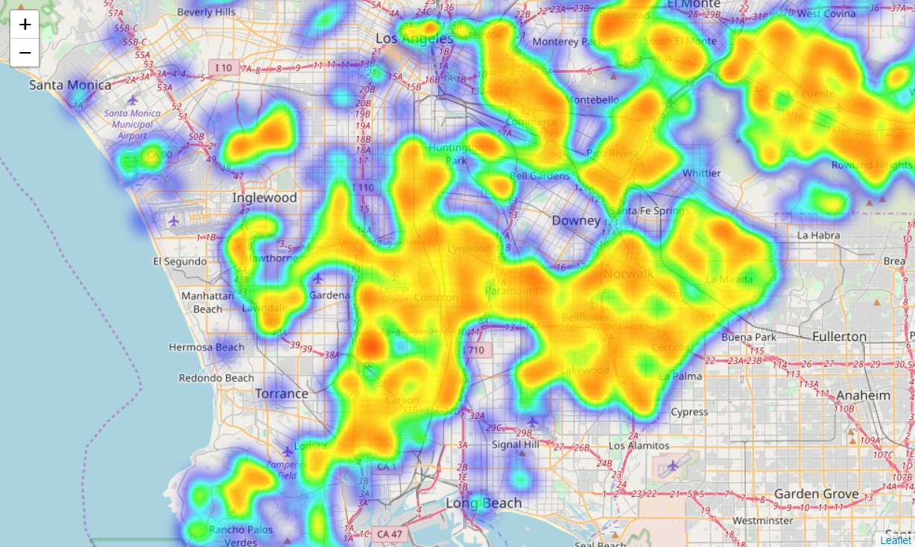



Crimes
$$$
$
$
Inglewood/Compton
$$$

Slide 9
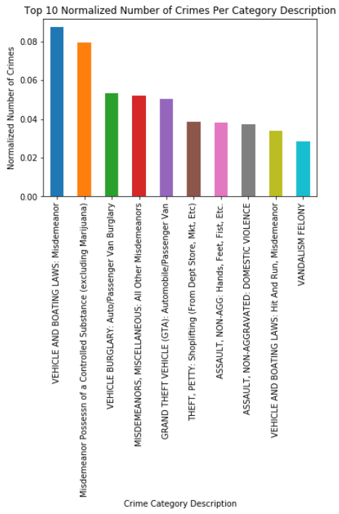
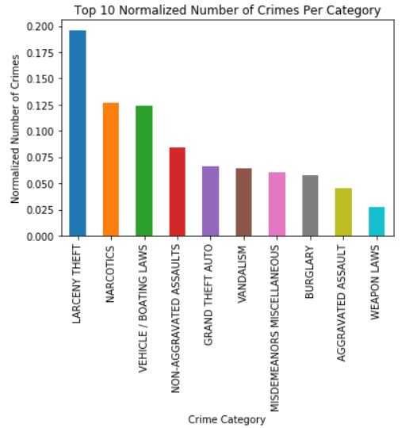
Crimes

Slide 10
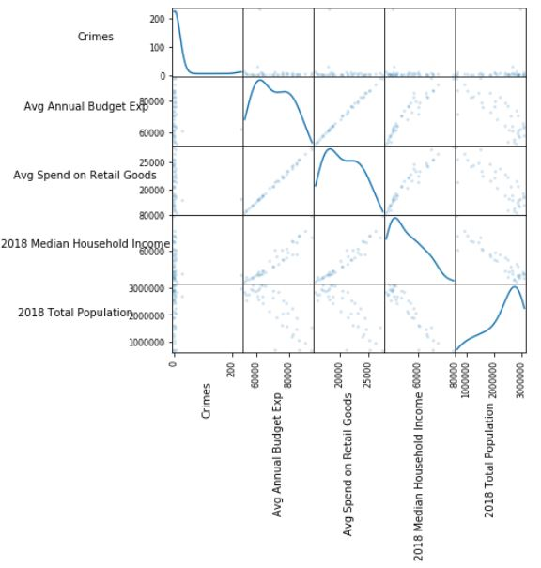
Analysis using
Geoenrichment
In AGOL, enrich crimes buffer with the following metrics:
average annual budget expenses,
average retail spend,
median household income,
and population

Slide 11
Important Insights
Looking at the map, there are clusters of crimes around areas of lower income households and dirtier streets.
This means there is a spatial correlation between crimes, income, and clean streets.
All of the top cities based on clean streets, income, and crime, have very clean streets and little to no crime.

Slide 12
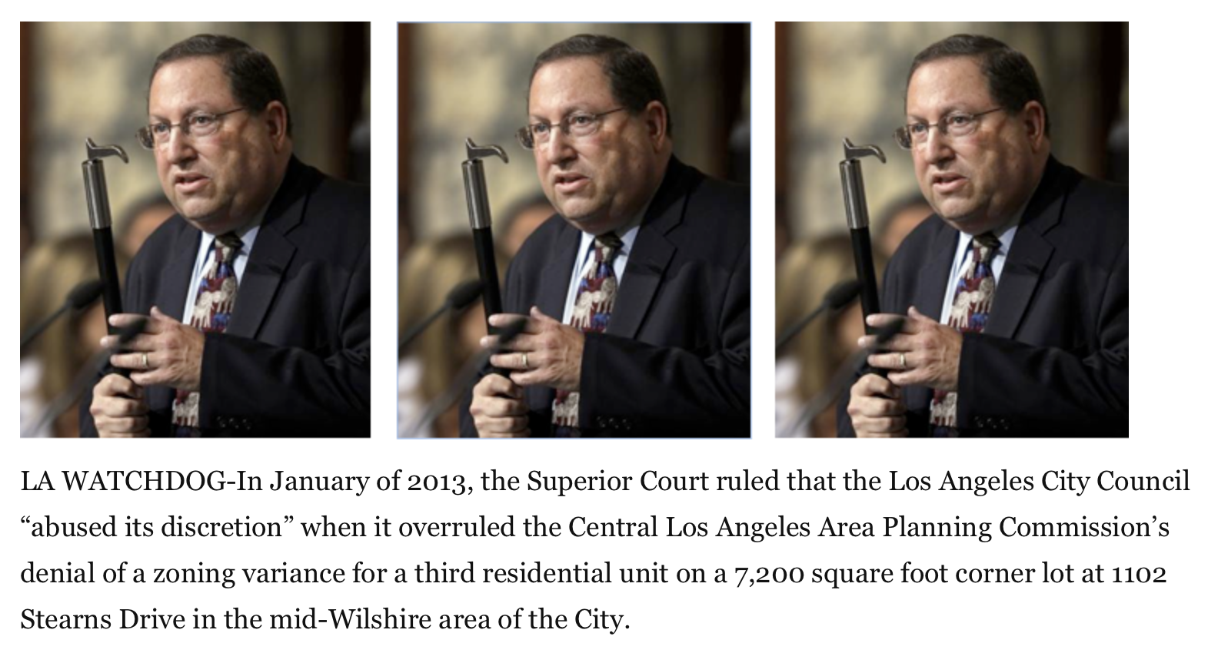
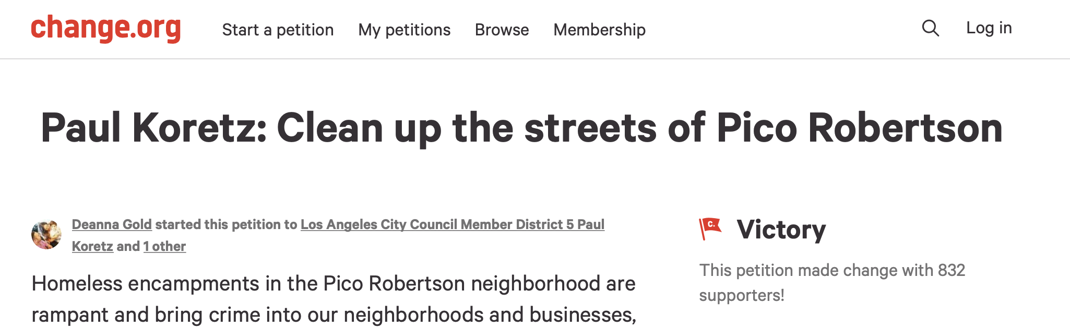
Important Insights
Average Household Income (US Dollars) and Best Streets to Set Up Businesses for Top Cities:
Westwood/UCLA (Northwest)
$128,813
Wilshire Boulevard
Council District 5 - Paul Koretz: indifferent about cleaning streets
In October 2018 (Q4 2018), someone created a petition to clean up the streets of the Pico Robertson neighborhood:

Slide 13
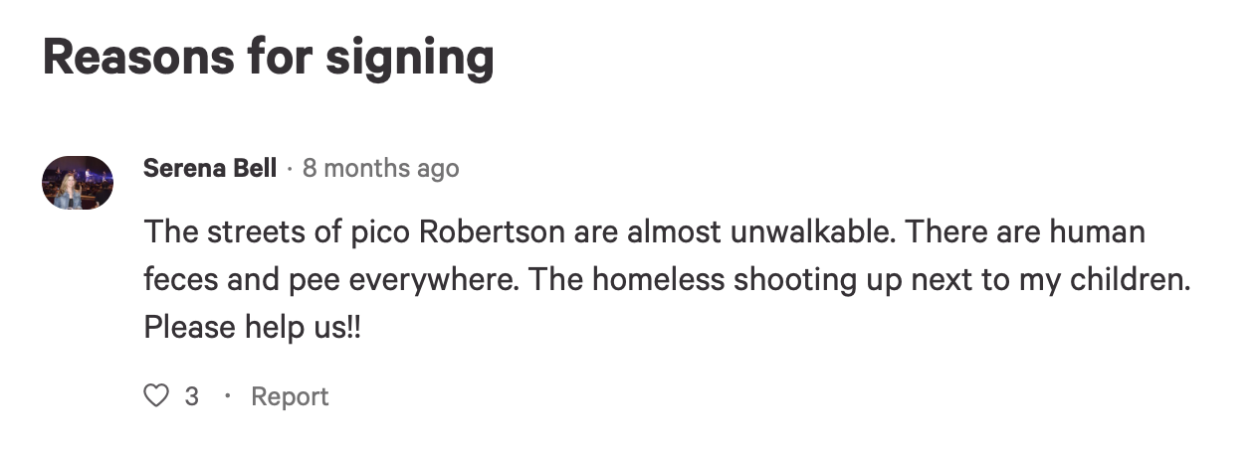

Slide 14
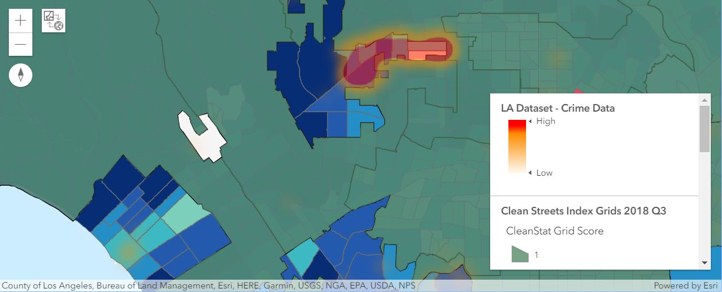
Important Insights

Slide 15
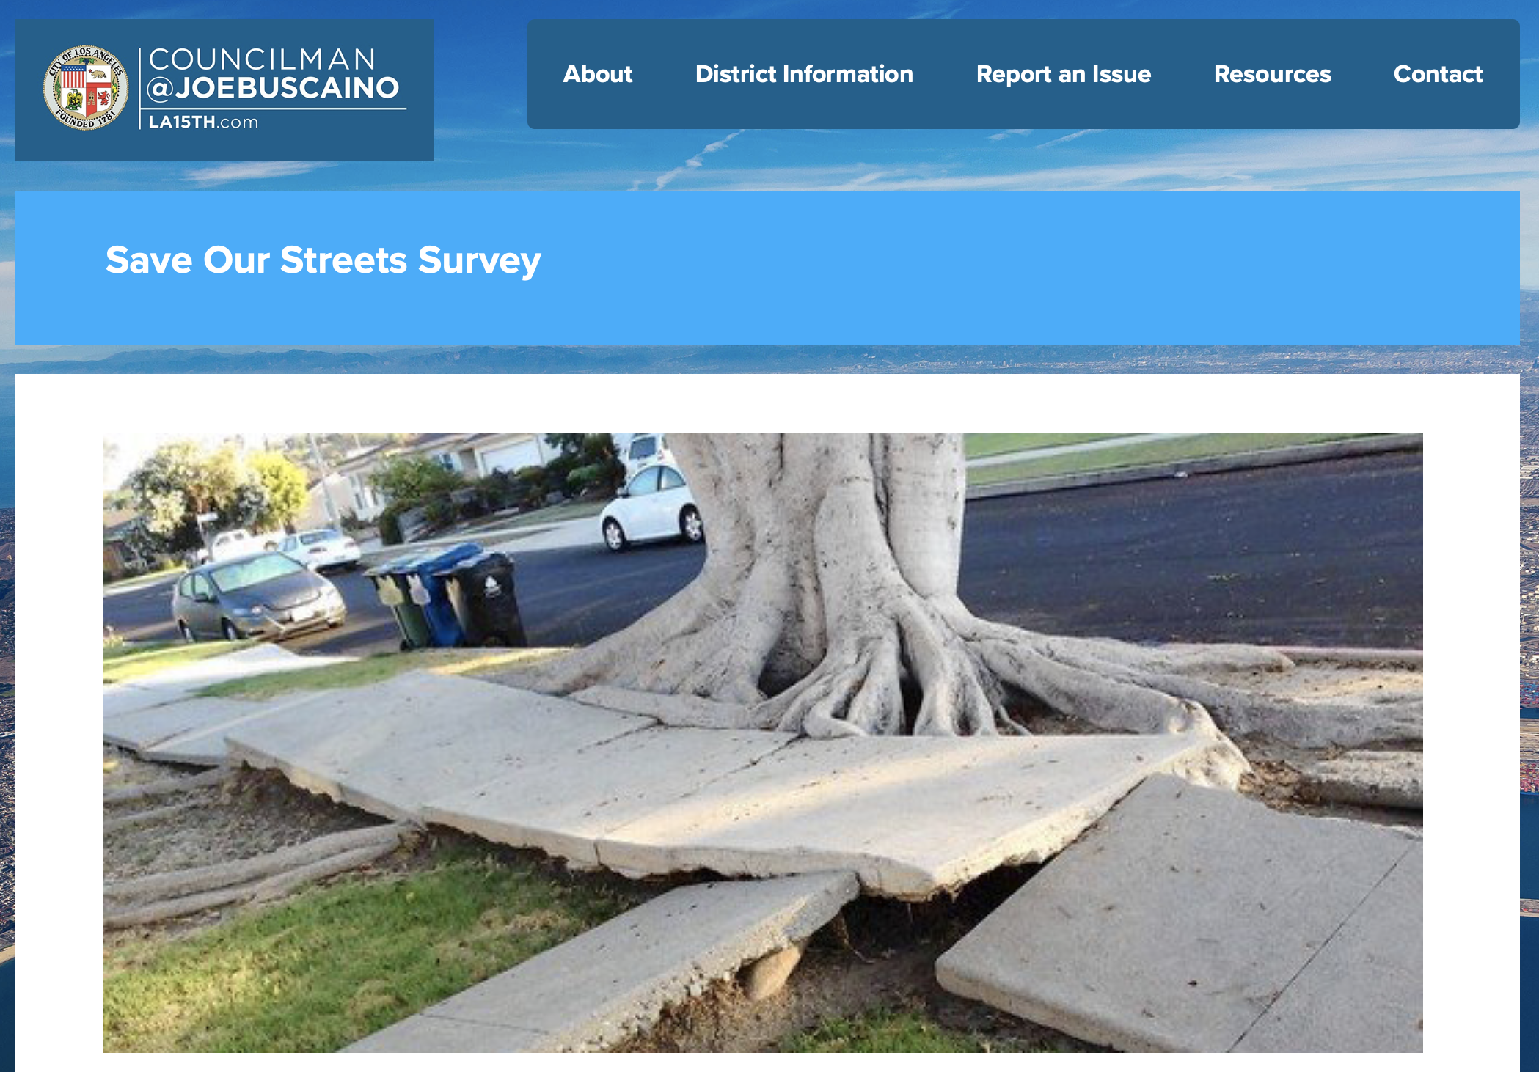
Important Insights
San Pedro/Rancho Palos Verde (coast/South)
$118,893
South Pacific Avenue
Council District 15 - Joe Buscaino: sincere about cleaning streets
His 'Save Our Streets' post on his website:

Slide 16
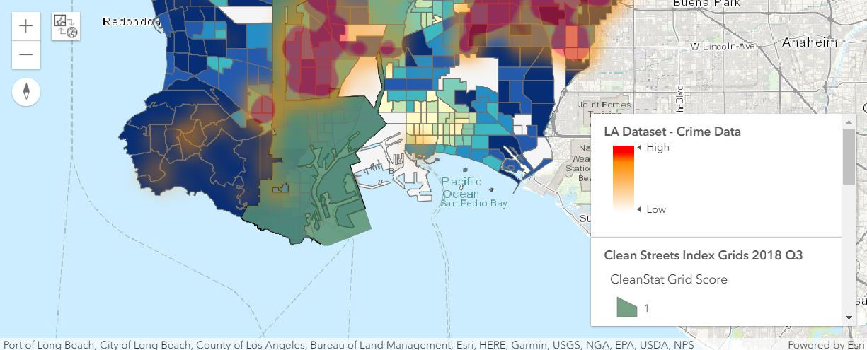
Important Insights

Slide 17
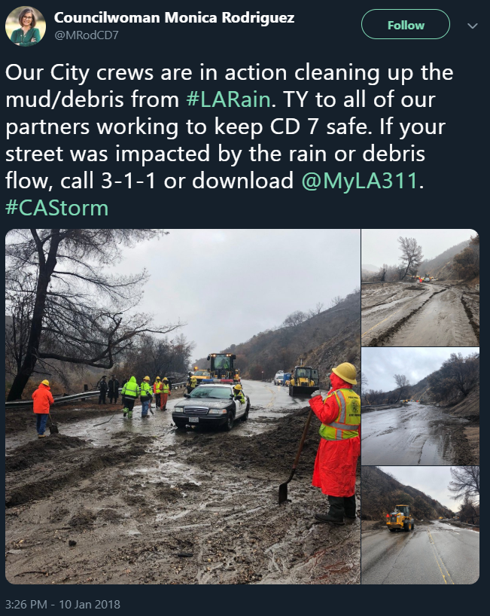
Important Insights
Granada Hills/San Fernando (North)
$111,532
Rinaldi Street
Council District 7 - Monica Rodriguez:
Sincere about cleaning streets:

Slide 18
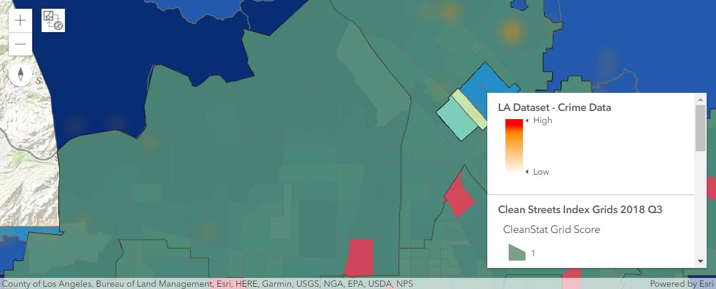
Important Insights

Slide 19

Important Insights
Pasadena (Northeast)
$70,845
South Arroyo Parkway, South Fair Oaks Avenue
Council District 14 - Jose Hulzar
His post about the Team Up to Clean Up event on his website:

Slide 20
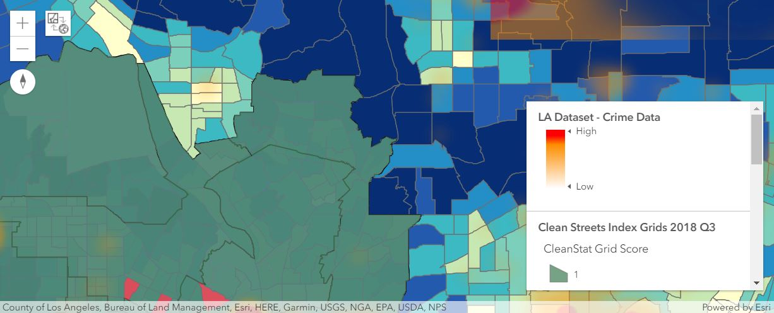
Important Insights

Slide 21
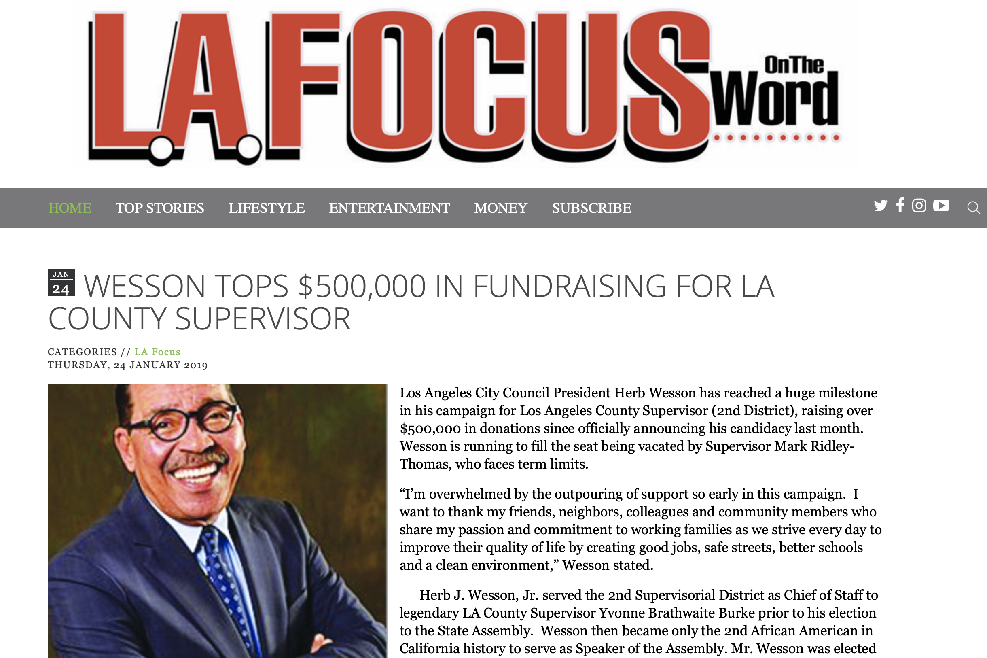
Important Insights
South Los Angeles/Culver City (Central)
$51,430
West Slauson Avenue, Figueroa Street
Council District 10 - Herb J. Wesson, Jr.
A newspaper article saying he raised over 500,000 USD in donations:

Slide 22
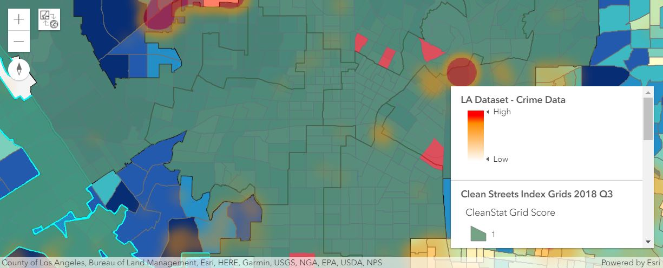
Important Insights

Slide 23
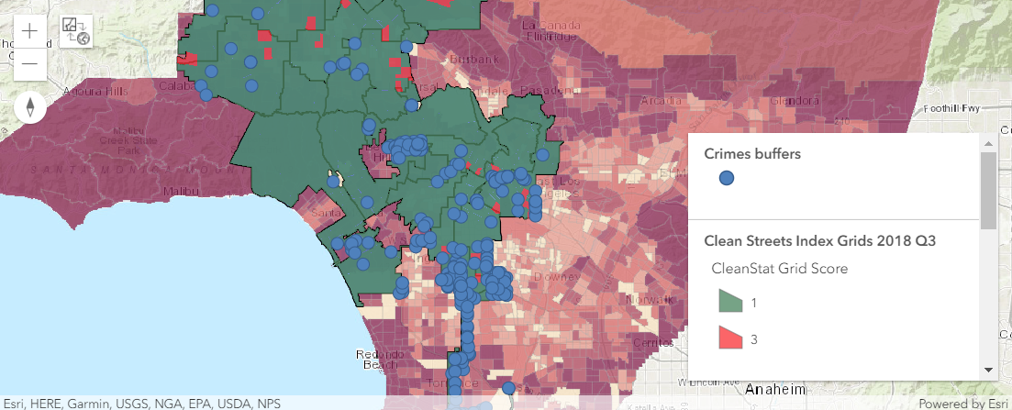
Important Insights

Slide 24

Conclusions and Future Work
Throughout our analysis, we concluded that there is a correlation between clean streets, income, and crimes.
Despite coming to this conclusion, our practical business use case can be tested only if an actual business owner uses our findings and insights to pick an optimal location to set up their business.
Then, we would have to collect business and financial data from that business and perform data science and analysis to substantiate our conclusion based on a real-world use case. Afterwards, we could confidently say that we completely answered our initial research question.

Slide 25

Conclusions and Future Work
One additional data set that we could incorporate into our analysis is the average monthly income and profit of different business types in certain districts.
Using this data set, we could get a better informed decision of the optimal locations for business owners to set up businesses.
Another additional data set could be the clean streets datasets from an earlier time period to see any continuities and changes over time in clean streets, income, and crimes.

Slide 26

Conclusions and Future Work
Our approach could be extended to other geographic regions besides LA County to get insights on the optimal locations for business owners to set up businesses in other parts of the world.
For example, if a business owner wants to create an international office in England, then we could implement our approach to a specific location in England and find the optimal locations so the business owner could make a better informed decision on where to set up their business.
Ultimately, we expect the results to be used by business owners looking to open their first location of a brand new business or open a new location of an existing business.

